Slide 1
Neural Networks Semester 1 Practical works for GRIAT RCSE master program Teacher: Makhmutova Alisa AZMakhmutova@kai.ru

Slide 2
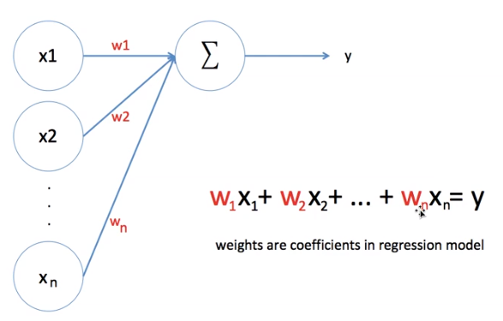
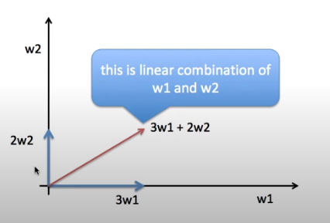
Linear Models

Slide 3
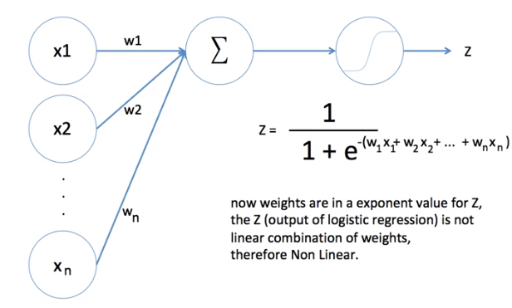
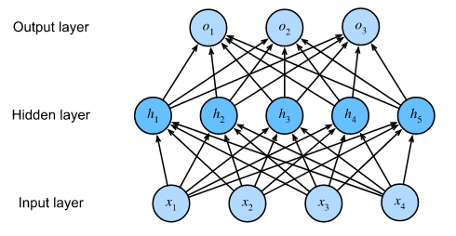


Incorporating Hidden Layers

Slide 4
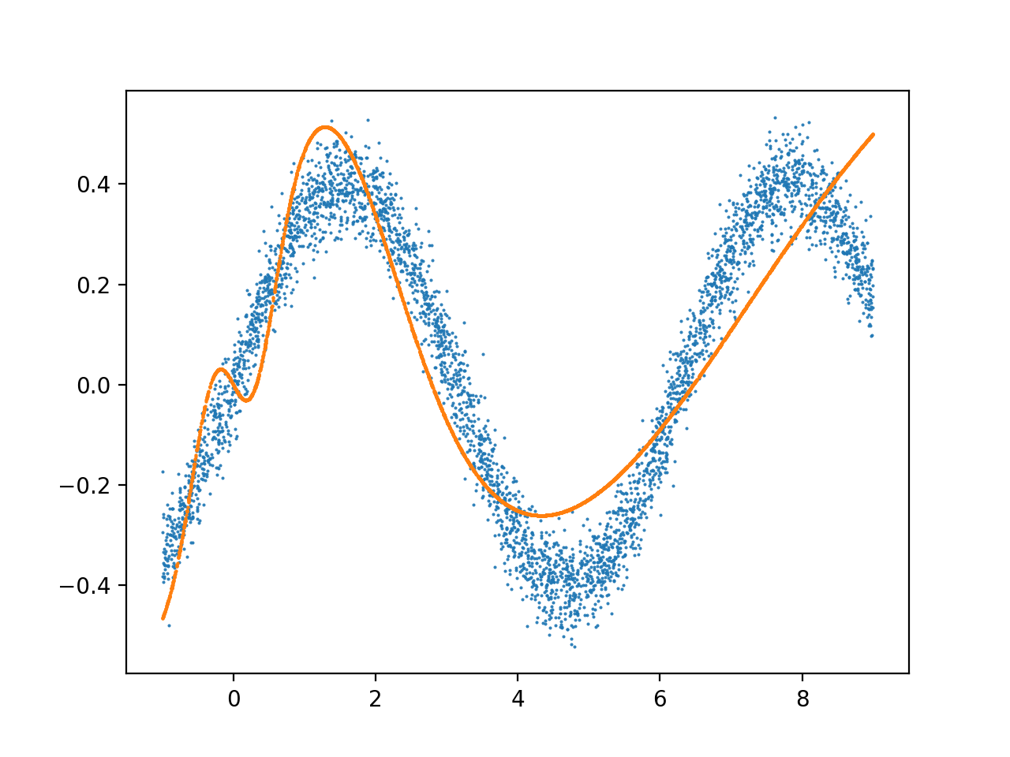
MLP as Universal Approximators

Slide 5
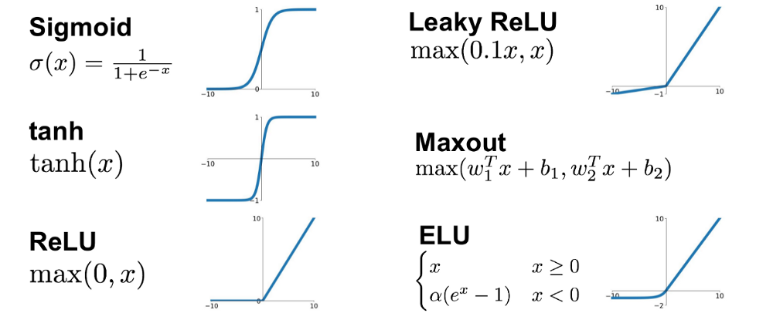
Activation Functions

Slide 6
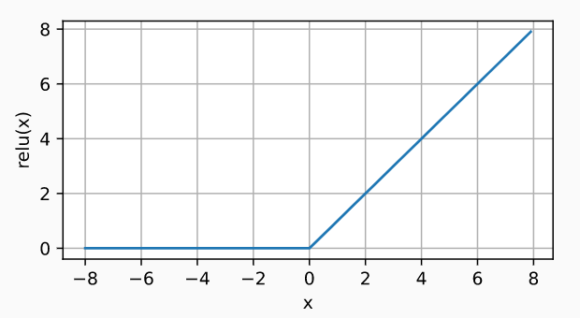
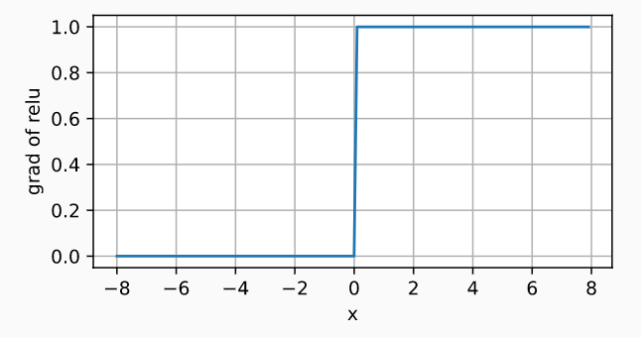
ReLU Function

Slide 7
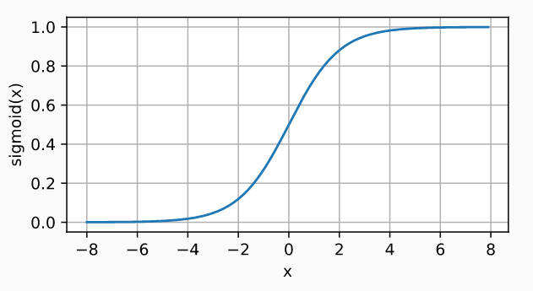
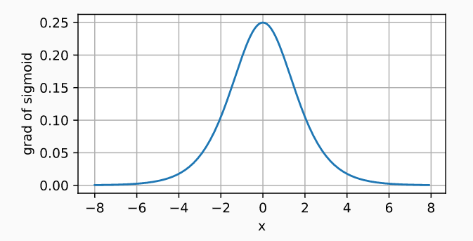
Sigmoid Function

Slide 8
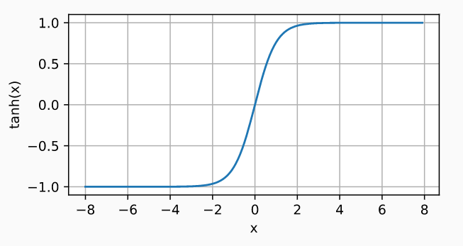
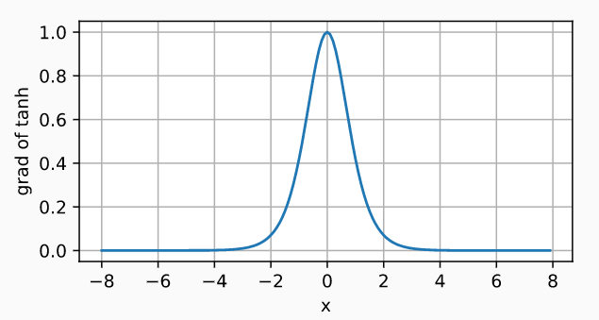
Tanh Function

Slide 9
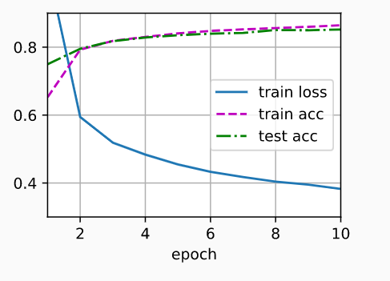
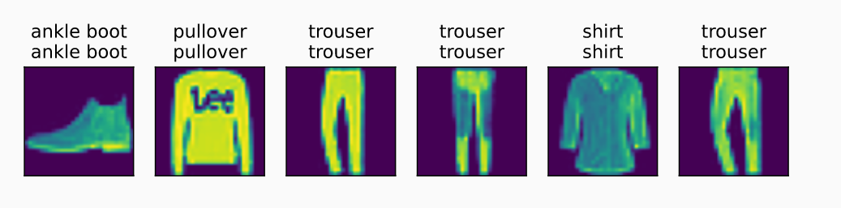
Implementation of Multilayer Perceptrons from Scratch

Slide 10
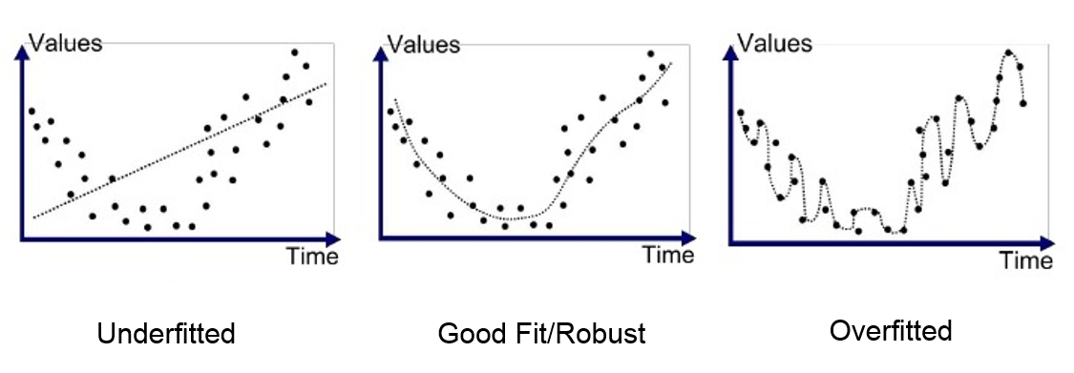
Model Selection, Underfitting, and Overfitting

Slide 11
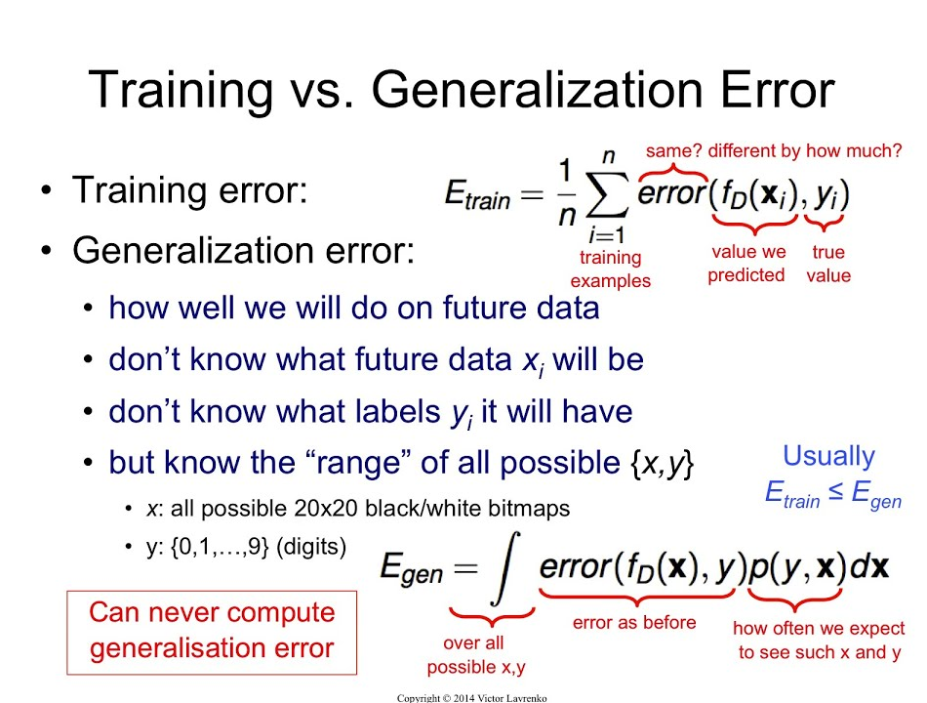
Training Error and Generalization Error

Slide 12
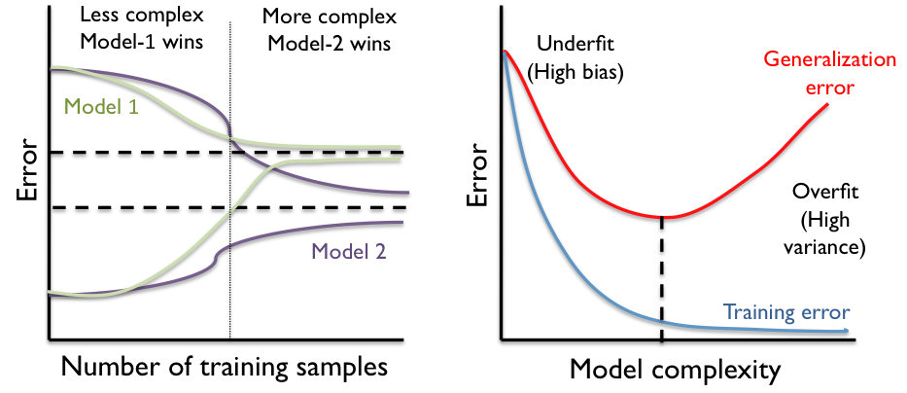
Model complexity

Slide 13
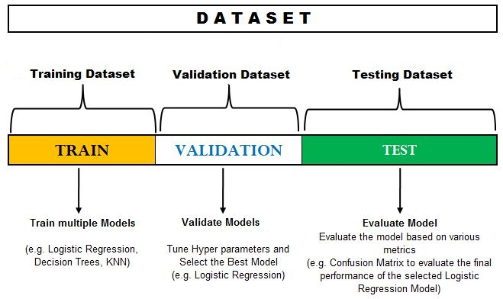
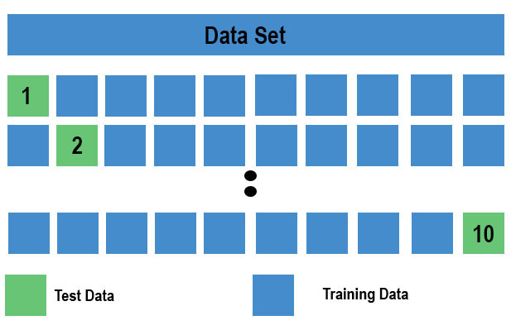
Datasets and K -Fold Cross-Validation

Slide 14
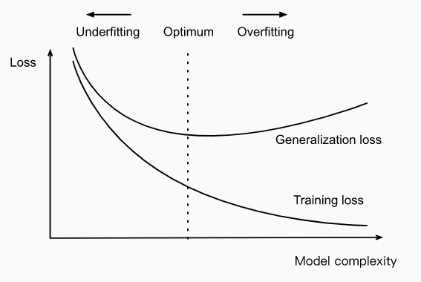

Underfitting or Overfitting

Slide 15

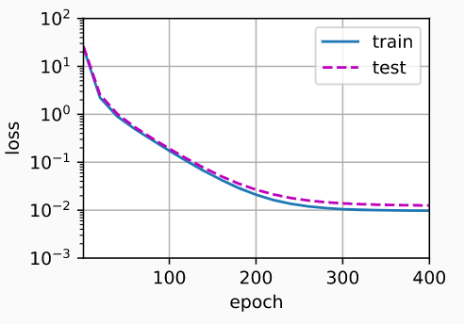
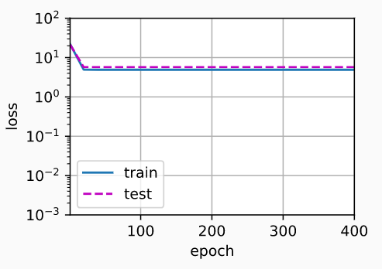
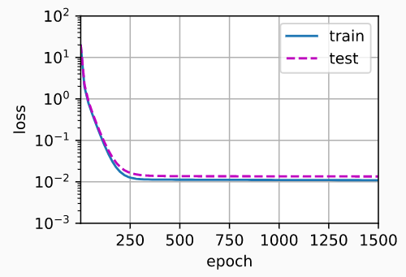
Polynomial Regression example

Slide 16
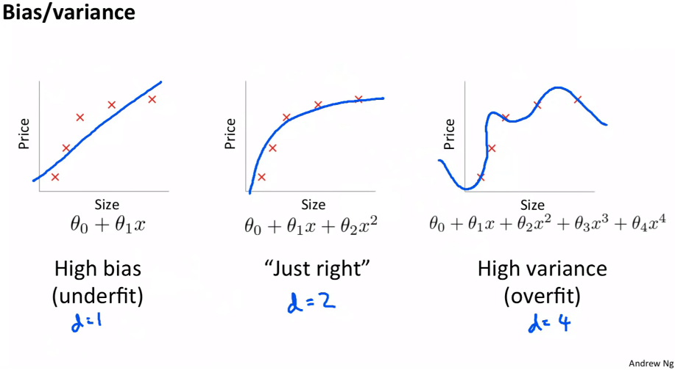
Norms and Weight Decay

Slide 17
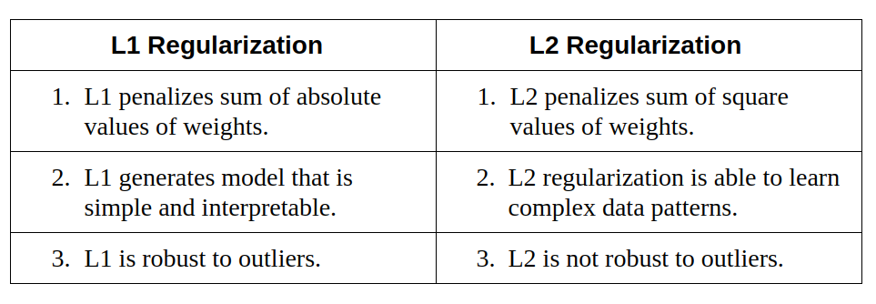


Regularization
lasso regression
ridge regression

Slide 18
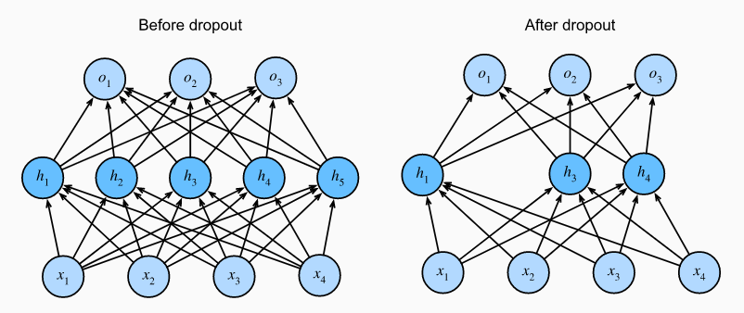
Dropout

Slide 19
Feed-forward and backpropagation
The backpropagation algorithm aims to minimize the error between the current and the desired output. The feed-forward learning models are:
Forward pass
Backward pass
There are two types of auto differentiation methods:
Reverse-mode: Derivation of a single output with respect to all inputs
Forward-mode: Derivation of all outputs with respect to one input

Slide 20
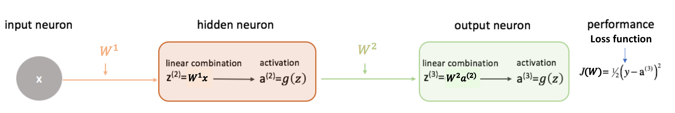
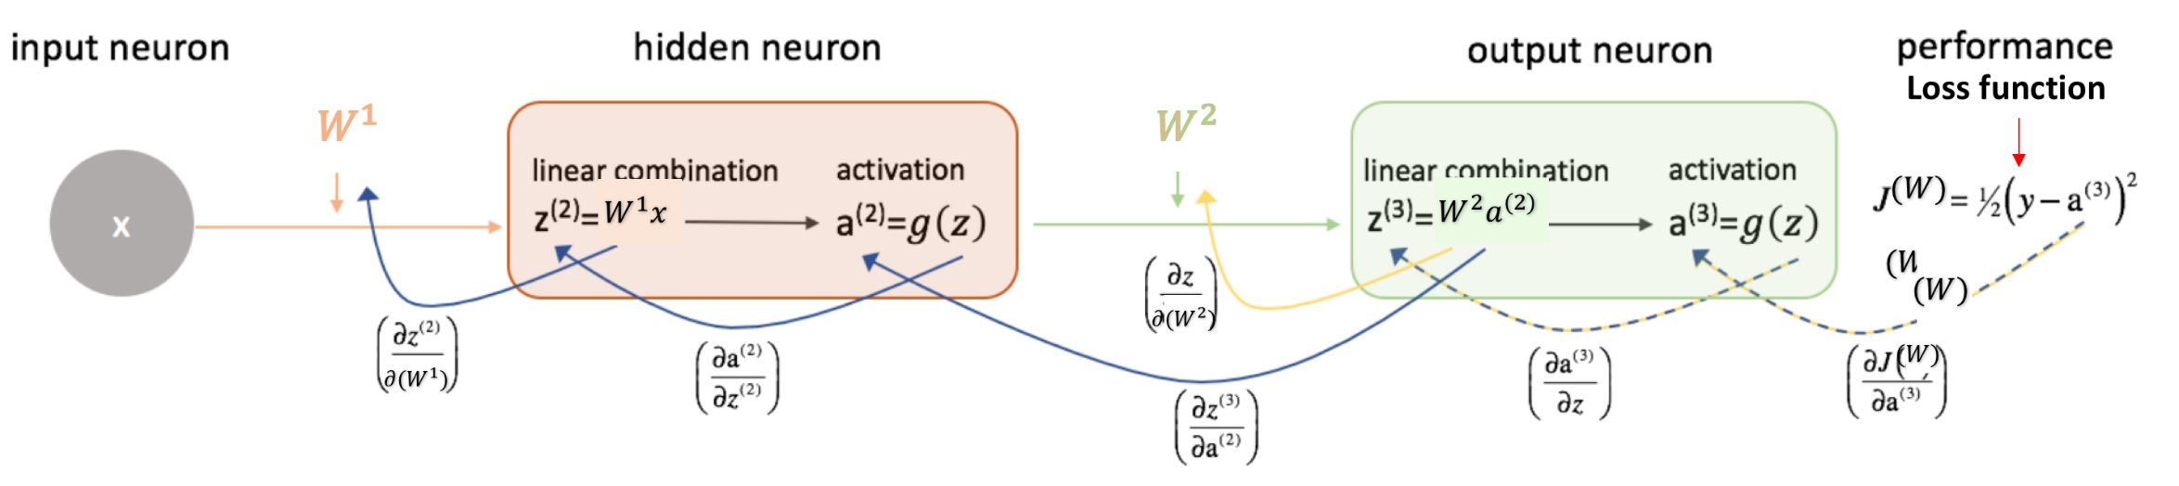
Feed-forward and backpropagation
Xavier initialization is nowadays used for training neural networks. It is similar to random initialization but often turns out to work much better.

Slide 21
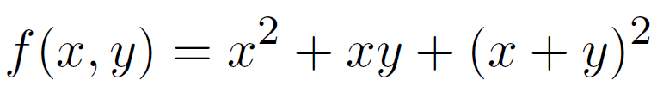
Derivatives of computational graph of function
A computation graph is a graph whose nodes are functions (usually fairly simple, taken from a predetermined set),
and the edges associate functions with their arguments
KNRTU-KAI | TU ILMENAU | Neural Networks

Slide 22
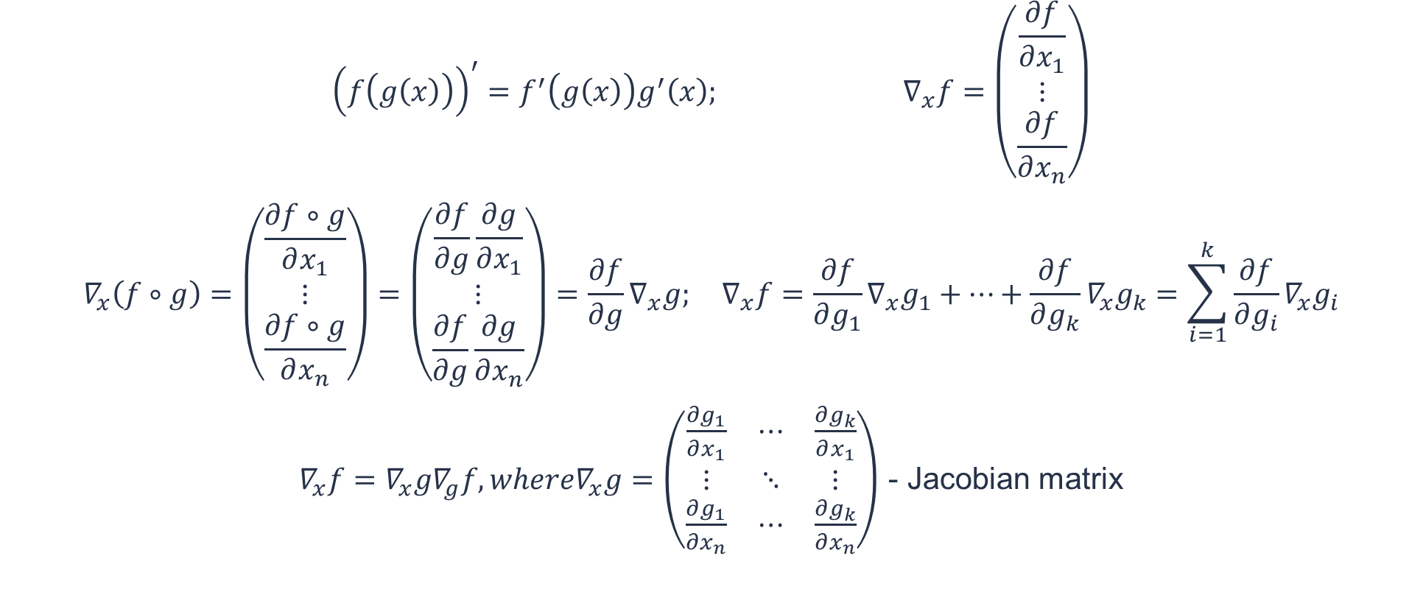
Derivatives of computational graph of function
$${\left(f\left(g\left(x\right)\right)\right)}^{′}=f^{′}\left(g\left(x\right)\right)g^{′}\left(x\right); ∇_{x}f=\left(\begin{matrix}\frac{∂f}{∂x_{1}} \\ ⋮ \\ \frac{∂f}{∂x_{n}}\end{matrix}\right)$$
$$∇_{x}\left(f∘g\right)=\left(\begin{matrix}\frac{∂f∘g}{∂x_{1}} \\ ⋮ \\ \frac{∂f∘g}{∂x_{n}}\end{matrix}\right)=\left(\begin{matrix}\frac{∂f}{∂g}\frac{∂g}{∂x_{1}} \\ ⋮ \\ \frac{∂f}{∂g}\frac{∂g}{∂x_{n}}\end{matrix}\right)=\frac{∂f}{∂g}∇_{x}g; ∇_{x}f=\frac{∂f}{∂g_{1}}∇_{x}g_{1}+…+\frac{∂f}{∂g_{k}}∇_{x}g_{k}=\sum_{i=1}^{k}{\frac{∂f}{∂g_{i}}}∇_{x}g_{i}$$
$∇_{x}f=∇_{x}g∇_{g}f, where∇_{x}g=\left(\begin{matrix}\frac{∂g_{1}}{∂x_{1}} & ⋯ & \frac{∂g_{k}}{∂x_{1}} \\ ⋮ & ⋱ & ⋮ \\ \frac{∂g_{1}}{∂x_{n}} & ⋯ & \frac{∂g_{k}}{∂x_{n}}\end{matrix}\right)$ - Jacobian matrix
KNRTU-KAI | TU ILMENAU | Neural Networks

Slide 23
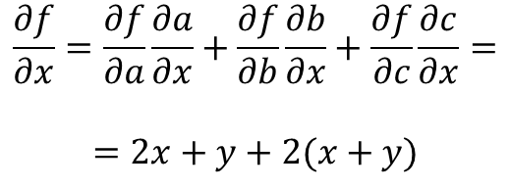
Derivatives of computational graph of function
$$\frac{∂f}{∂x}=\frac{∂f}{∂a}\frac{∂a}{∂x}+\frac{∂f}{∂b}\frac{∂b}{∂x}+\frac{∂f}{∂c}\frac{∂c}{∂x}=$$
$$=2x+y+2(x+y)$$
KNRTU-KAI | TU ILMENAU | Neural Networks

Slide 24
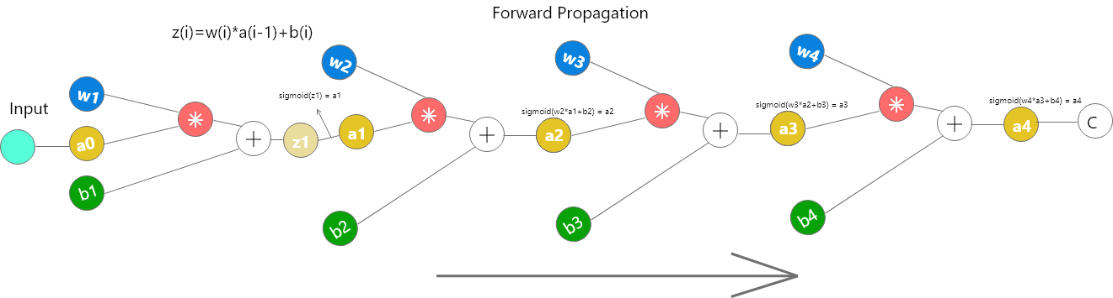
Numerical Stability and Initialization
Vanishing and Exploding Gradients

